Slide 1
Sensitive Data Exposure.
-2014UCP1012
Sarik Koirala
2014UCP1013
Pratyush Pratap Singh

Slide 2
Introduction:
1. Introduction to Data Breach and Sensitive Data Exposure
1.1 Introduction
1.2 Causes/Reasons of Data Exposure
1.3Effects
1.4 Prevention of Data Exposure
2. SQL Injection(SQLI)
2.1 Introduction
2.2 Types of attack
2.3 Working
2.4 Prevention
3. Cross Site Request Forgery(CSRF)
3.1 Introduction
3.2 Working
3.3 Prevention

Slide 3
4. Session Hijacking
4.1 Introduction
4.2 Working
4.3 Prevention
5. Man-In-The-Middle Attack
5.1 Introduction
5.2 Working
5.3 Prevention
6. Sniffer Attack
6.1 Introduction
6.2 Working
6.3 Prevention
7. Sources.

Slide 4
A data breach is a security incident in which sensitive, protected or confidential data is copied, transmitted, viewed, stolen or used by an individual unauthorized to do so.
Sensitive Data Exposure occurs when an application does not adequately protect sensitive information.
Data Exposure will leave the user vulnerable to Data breaches, which include:
Unintentional information disclosure,
Data leak and
Data spill.
Introduction

Slide 5
The data at risk :
Passwords,
Session tokens,
Credit card Information,
Personal Health Information(PHI),
Personally Identifiable Information(PII).
Introduction

Slide 6
Who/What poses a threat to Data integrity?
An organization might be subject to:
Internal Threats
Accidental Human errors
External Threats
Hackers,
Cybercriminal organizations and
State-sponsored actors.
Introduction

Slide 7
Reasons for Data Exposure:
• Intrusion
→ Weakness in operating system
• Phishing
→Tricked into thinking the website is trusted
• Social Engineering
→Posing to get information/ installing malicious software
Introduction

Slide 8
Reasons for Data exposure:
More specific reasons may include:
Lack of sufficient headers to prevent caching behind pages that require authentication.
Lack of HTTPS on authenticated pages.
Hashed passwords with lack of salt, making the password prone to being cracked.
Tokens being disclosed in public source code.
Introduction

Slide 9
Effects/Examples of Sensitive Data Exposure in the real world:
The Yahoo breach disclosed in 2016 may lower the price of its acquisition by Verizon by $1 billion.
Cybercrime cost Energy and utilities companies a loss of $12.8 million in 2015 in lost business and damaged equipment .
Data breaches cost Healthcare organizations $6.2 billion in the last two years (presumably 2015 and 2016),
100 million passwords in plain text from VK.com were recently leaked in 2016.
100
Introduction

Slide 10
Prevention to Data exposure:
Step 1:
Figure which data is sensitive and important to protect.
Step 2:
Go over each of these data points to make sure
The data is never stored in clear text.
The data is never transmitted in clear text.
Example → Between database and server, or over the internet.
The algorithms used to encrypt the data are considered strong enough.
The generation of the keys is secure.
Browser headers are set to not cache when the sensitive data is
presented to end-user.

Slide 11
SQL Injection:

Slide 12
Introduction
SQL Injection a code injection technique.
It is used to attack data-driven applications.
Nefarious SQL statements are inserted into an entry field for execution.
SQLI exploits a security vulnerability in an application's software
When user input is either incorrectly filtered for string literal escape characters embedded in SQL statements
When the user input is not strongly typed and unexpectedly executed.

Slide 13
Types of Attack
SQL injection (SQLI) is considered one of the top 10 web application vulnerabilities of 2007 and 2010 by the Open Web Application Security Project . In 2013, SQLI was rated the number one attack on the OWASP top ten . There are four main sub-classes of SQL injection:
Classic SQLI
Blind or Inference SQL injection
Database management system-specific SQLI
Compounded SQLI

Slide 14
Working of SQLI
global $wpdb;
$title = $wpdb->get_var("select post_title from " . $wpdb->posts . " where ID=" . $_GET['id']);
echo $title;
The user input in $_GET[‘id’] is sent directly to the database without sanitization or escaping. This allows an attacker to send commands directly to the database.
Using this vulnerability an attacker can send commands directly to the database. These include SELECT commands to download your entire database including any user personally identifiable information (PII). In some cases it also includes INSERT and UPDATE commands to create new user accounts or modify existing user accounts.

Slide 15
Counter-measures against this attack
Hard Coding the Username and Password of the login into the application should be avoided or very strictly limited.
Avoid the use of DYNAMIC SQL code.
Check web config files for each application to ensure they do not have sensitive information
Use the most restrictive SQL account types for your applications which makes the account types READ ONLY (where possible). If READ/WRITE is required, ensure the file does not have additional accesses which are not needed

Slide 16
To fix the above vulnerability, the code can be modified as:
global $wpdb;
$title = $wpdb->get_var($wpdb->prepare("select post_title from " . $wpdb->posts . " where ID=%d", $_GET['id']));
echo $title;

Slide 17
Cross Site Request Forgery (CSRF)

Slide 18
Introduction
CSRF is an attack that forces an end user to execute unwanted actions on a web application.
Via social engineering, a successful CSRF attack can force the user to perform state changing requests like
Transferring funds,
Changing their email address
**If the victim is an administrative account, CSRF can compromise the entire web application.

Slide 19
Working of CSRF:
Say, a user visits site B while logged into a web site A.
Page does a GET (or POST) to a page X on site A (which the user is logged in to)
Example:
Using an already authenticated session/cookie, Page X by design causes change in state of your account.

Slide 20
Prevention of CSRF:
The CSRF prevention techniques include:
Synchronizer token pattern
Cookie-to-Header Token
Client side safeguards
The most common method to prevent CSRF:
Append unpredictable challenge tokens to each request and associate them with the user’s session.
Such tokens should at a minimum be unique per user session, but can also be unique per request.
challenge token with each request, the developer can ensure that the request is valid.

Slide 21
Session Hijacking

Slide 22
Introduction
Also known as TCP session hijacking.
It is a method of taking over a Web user session by surreptitiously obtaining the session ID and masquerading as the authorized user.
Once the user's session ID has been accessed, the attacker can do anything the user is authorized to do on the network.

Slide 23
Working of Session Hijacking:
An attacker logs into the site(say www.vulnerablesite.com). The server sets a cookie value and returns it to him, say Set-Cookie: SID=adfajkdfjer23411sdfadf
The attacker now sends a link to the victim, http://www.vulnerablesite.com/test.php?SID= adfajkdfjer23411sdfadf
The victim logs on and the server now assigns the SID value to him. (Why? Due to bad coding, the server does not check if it is generated by itself and tags it with the users).
The attacker, who already knows the SID value he used, can now just use the same and access the victim’s account.

Slide 24
Prevention of Session Hijacking:
If the application does not use SSL and transports the data in plain text, then anyone within the same network can grab the cookie values just by sniffing the traffic using tools such as Wireshark.
Cases:
SSL only for login page: Some developers use SSL for the login page alone, assuming that the credentials are transported safely. But once the user is authenticated, it is the cookies (each request) that identify him. All the requests that are done after logging in contain cookies, and if they are not protected with SSL, the session can be easily hijacked.
Single URL is enough to hijack a user: The application which uses HTTP to fetch image or JS files that belong to same domain. when you send a request to a domain in which you are already signed in, the cookies would automatically go. even if there is a single link which goes to the server without HTTPS, the cookies would go along with it and can be grabbed by an attacker who is sniffing the network.

Slide 25
Man-In-The-Middle Attack

Slide 26
Introduction
The man-in-the middle attack intercepts a communication between two systems.
Example: In an http transaction the target is the TCP connection between client and server. Using different techniques, the attacker splits the original TCP connection into 2 new connections, one between the client and the attacker and the other between the attacker and the server.
Once the TCP connection is intercepted, the attacker acts as a proxy, being able to read, insert and modify the data in the intercepted communication.

Slide 27
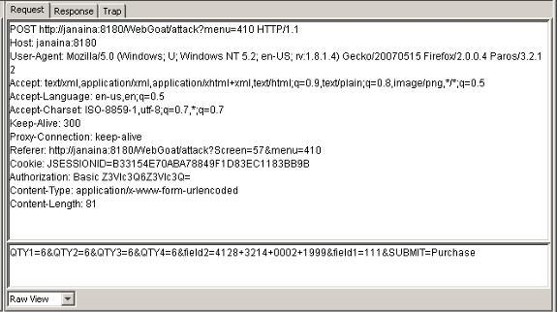

Slide 28
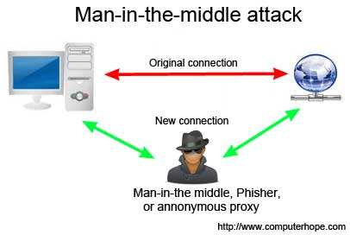

Slide 29
Working of MIMA:
In most common MITM attacks,
The attacker mostly uses a WiFi router to intercept user’s communication. This technique can be work out by exploiting a router with some malicious programs to intercept user’s sessions on the router.
First, he attacker configures his laptop as a WiFi hotspot, choosing a name commonly used in a public area, such as an airport or coffee shop.
Once user connects to that malicious router to reach websites such as online banking sites or commerce sites, attacker then logs user’s credentials for later use.

Slide 30
Prevention of MIMA
Note: Most of the effective defenses against MITM can be found only on router or server-side. You won’t be having any dedicated control over the security of your transaction.
Instead, you can use a strong encryption between the client and the server.
In this case server authenticates client’s request by presenting a digital certificate, and then only connection could be established.
Another method to prevent such MITM attacks is, to never connect to open WiFi routers directly.
However, if you wish to do so, you can use a browser plug-in such as HTTPS Everywhere or ForceTLS. These plug-ins will help you establishing a secure connection whenever the option is available.

Slide 31
Sources:
Wikipedia.com/Data Breach
blog.detectify.com
Owsap.org
Msdn.Microsoft.com
W3school.com

Slide 32
Screenshots Of Practical Implementation

Slide 33
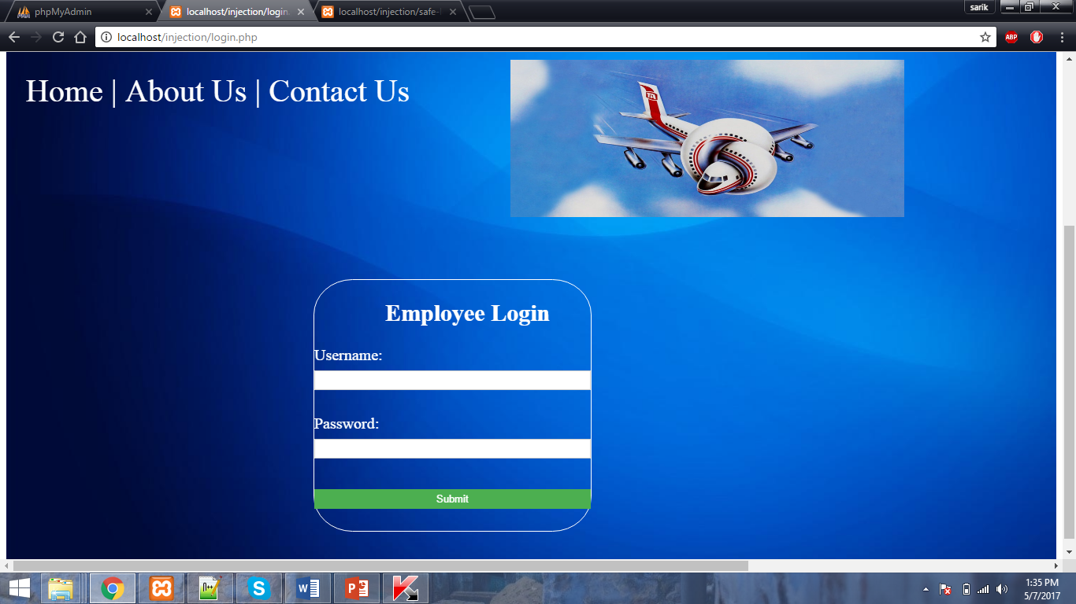

Slide 34
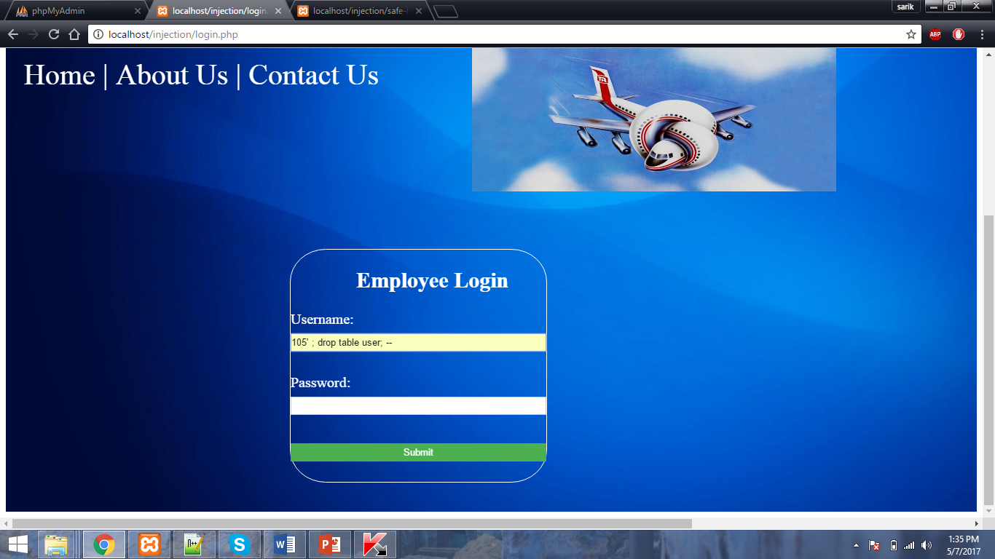

Slide 35


Slide 36
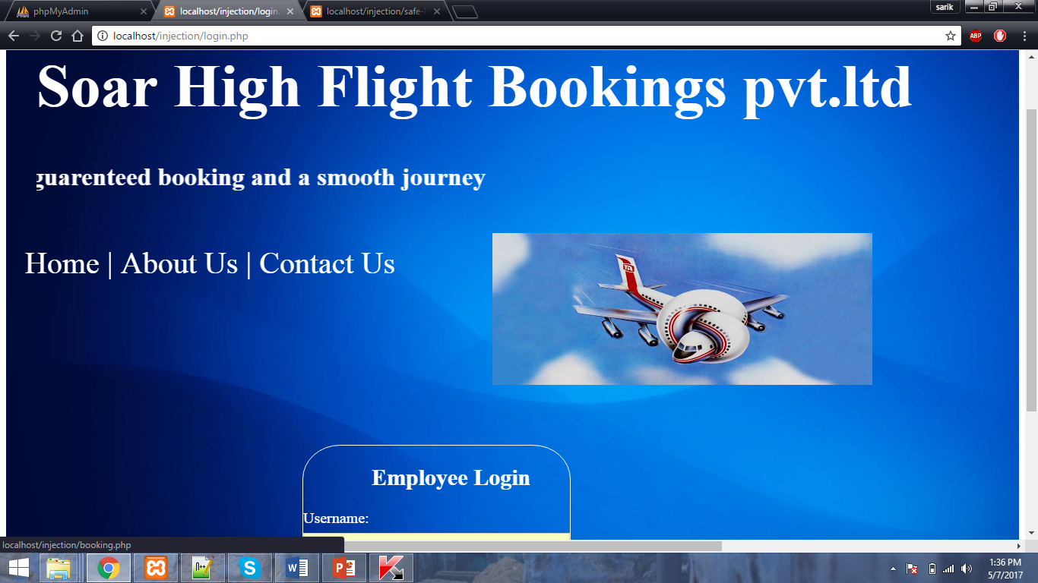

Slide 37


